Slide 1
Bridge Model for Individualized Digital NasoAlveolar Molding using Uniform Cross-Section Elliptic Segment
H. Parakarn¹, B. Wangsrimongkol¹, N. Eua-Anan², and T. Katanyukul²
¹Faculty of Dentistry and ²Faculty of Engineering, Khon Kaen University, Thailand
ITTA 2024, 23-25 April, Baku, Azerbaijan

Slide 2
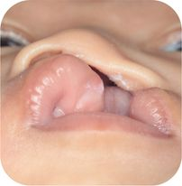
Cleft Lip and Palate (CLP)
* Congenital craniofacial defect.
* Approximately 1 in 700 births.
* Caused by various factors, inc. genetic, environmental, or combination of both.
* NasoAlveolar Molding (NAM) is a well-adopted adjunctive therapy before lip surgery.

Slide 3
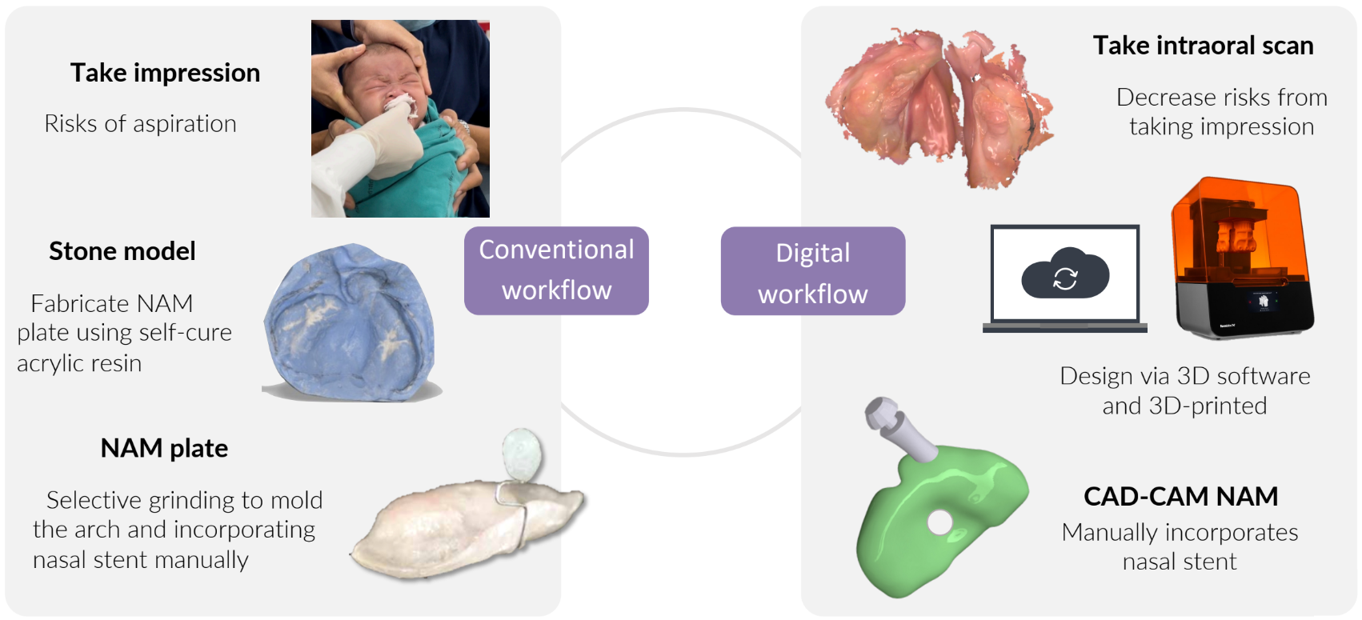
Conventional and Digital NAMs

Slide 4
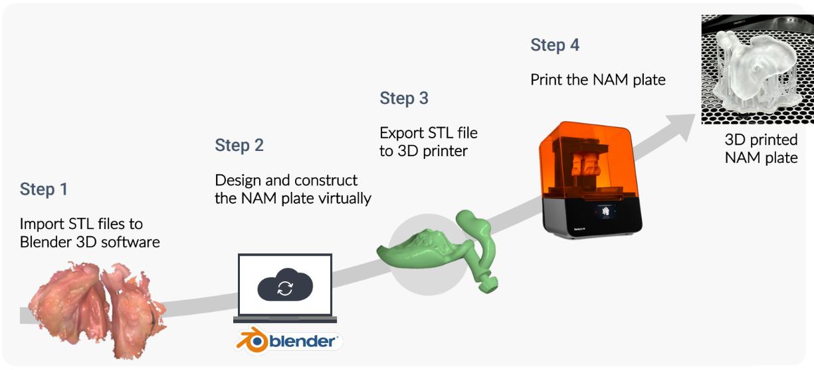
Individual Digital NAM

Slide 5
Issues
Need a personnel with both craniofacial expertise and proficiency in 3D modeling

Slide 6
Our Proposed Solution
Automate or provide semi-automation

Slide 7
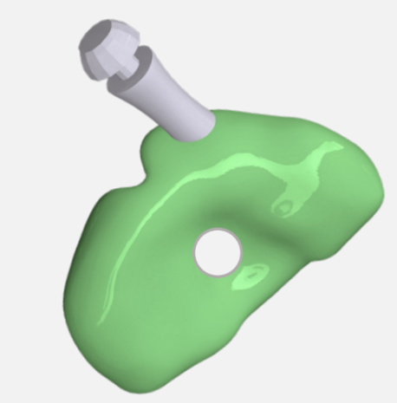
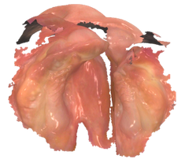
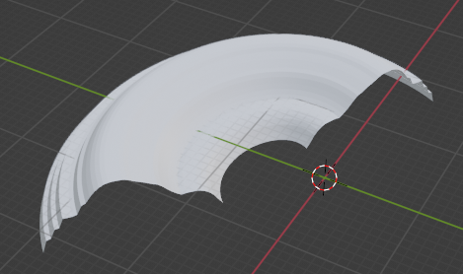
Project Phases
Input
Intra-Oral Scan
Phase 1
Bridge
Final Design

Slide 8
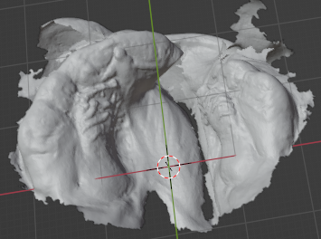
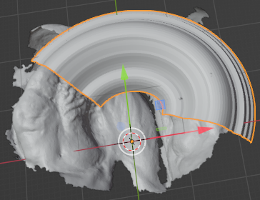
The Bridge Model
Intra-Oral Scan
Bridge
* Its shape agrees with curvature of a patient’s alveolar ridge.
* It connects the gap.
* Its volume loosely fits to the alveolar ridge.
Bridge

Slide 9
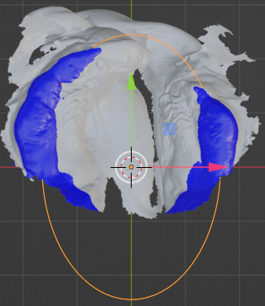
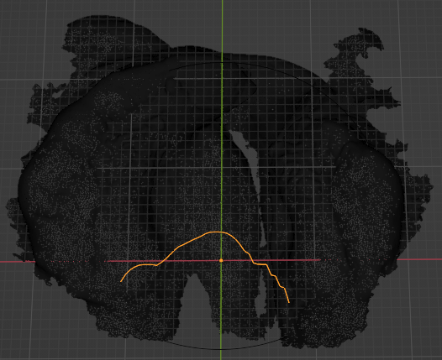
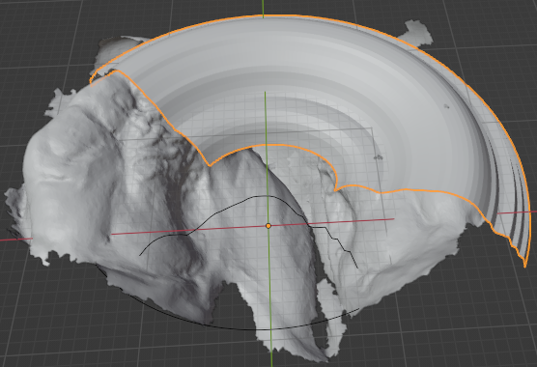
Our Approach
Uniform Cross-Section Elliptic Segment
Shape: ellipse model
Cross-section
Bridge: shape + cross-section

Slide 10
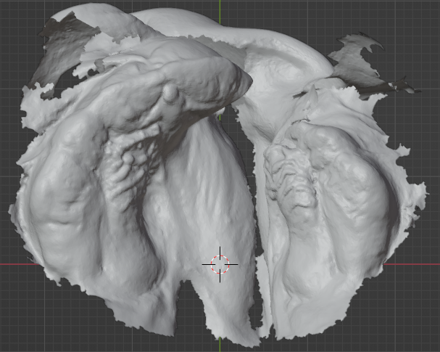
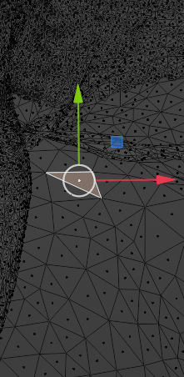
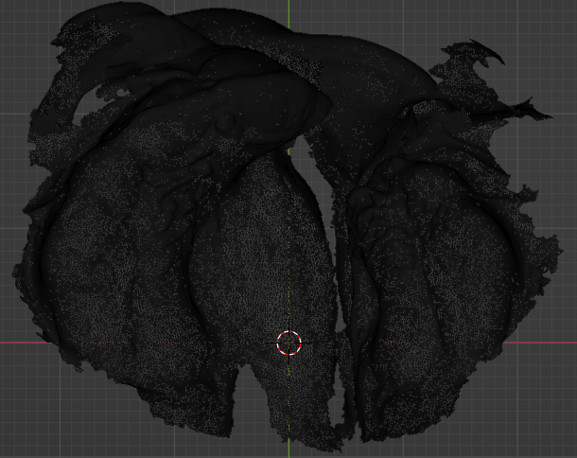
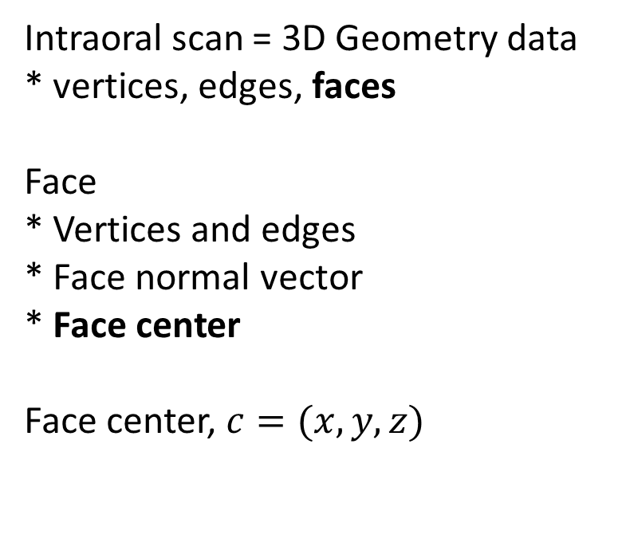
Working with 3D Geometry Data
Intraoral scan = 3D Geometry data
* vertices, edges, faces
Face
* Vertices and edges
* Face normal vector
* Face center
Face center, $c=(x, y, z)$

Slide 11
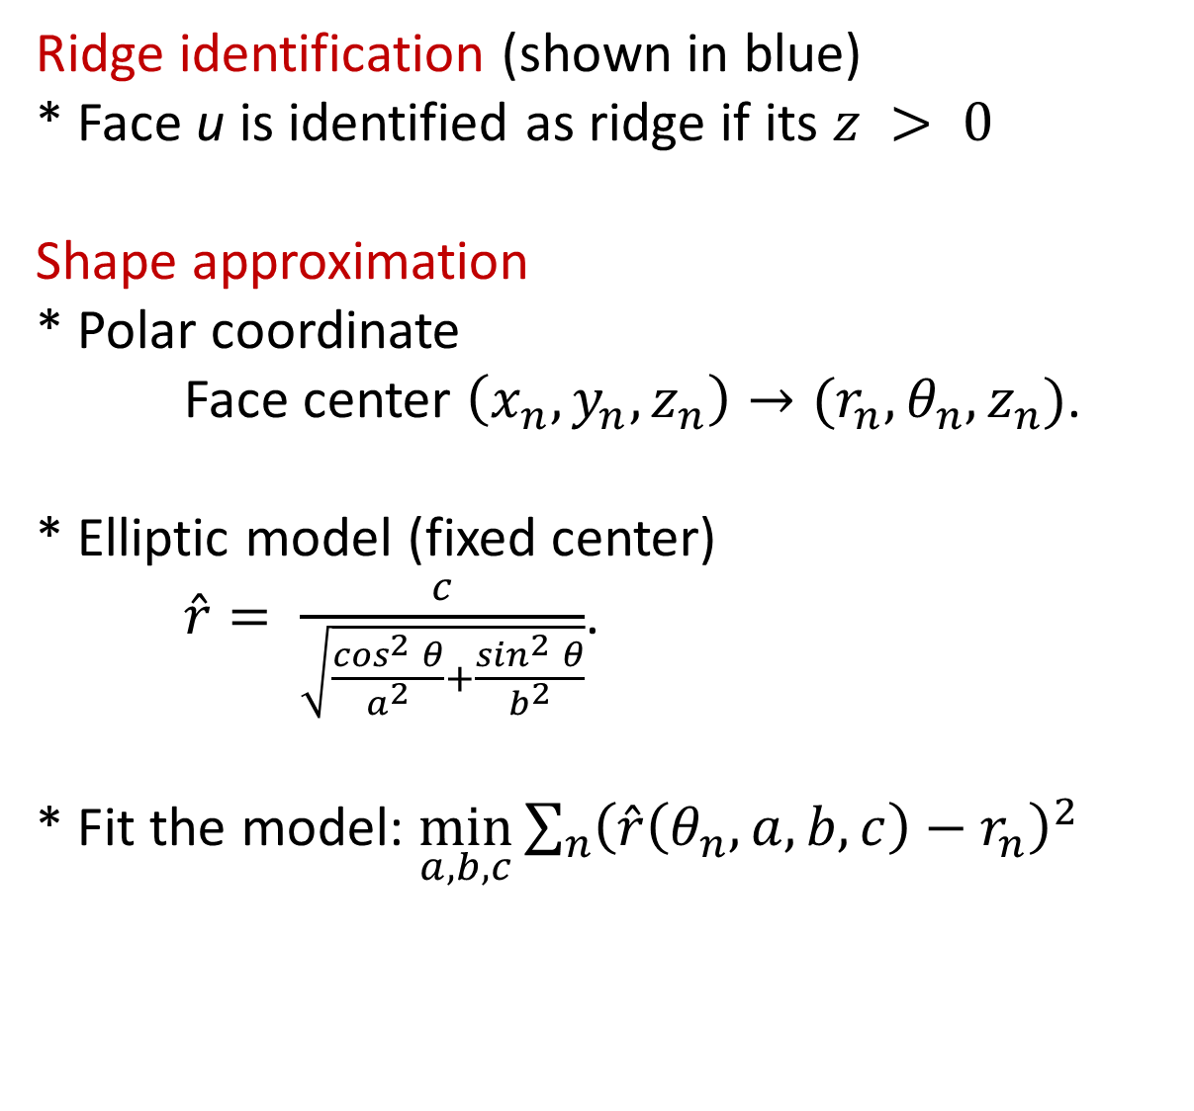
Elliptic Segment
Ridge identification (shown in blue)
* Face u is identified as ridge if its $z > 0$
Shape approximation
* Polar coordinate
Face center $\left(x_{n},y_{n},z_{n}\right)→(r_{n},θ_{n},z_{n})$.
* Elliptic model (fixed center)
$\hat{r}= \frac{c}{\sqrt{\frac{\cos^{2}{θ}}{a^{2}}+\frac{\sin^{2}{θ}}{b^{2}}}}$.
* Fit the model: $\min_{a,b,c}{\sum_{n}{{\left(\hat{r}\left(θ_{n},a,b,c\right)−r_{n}\right)}^{2}}}$

Slide 12
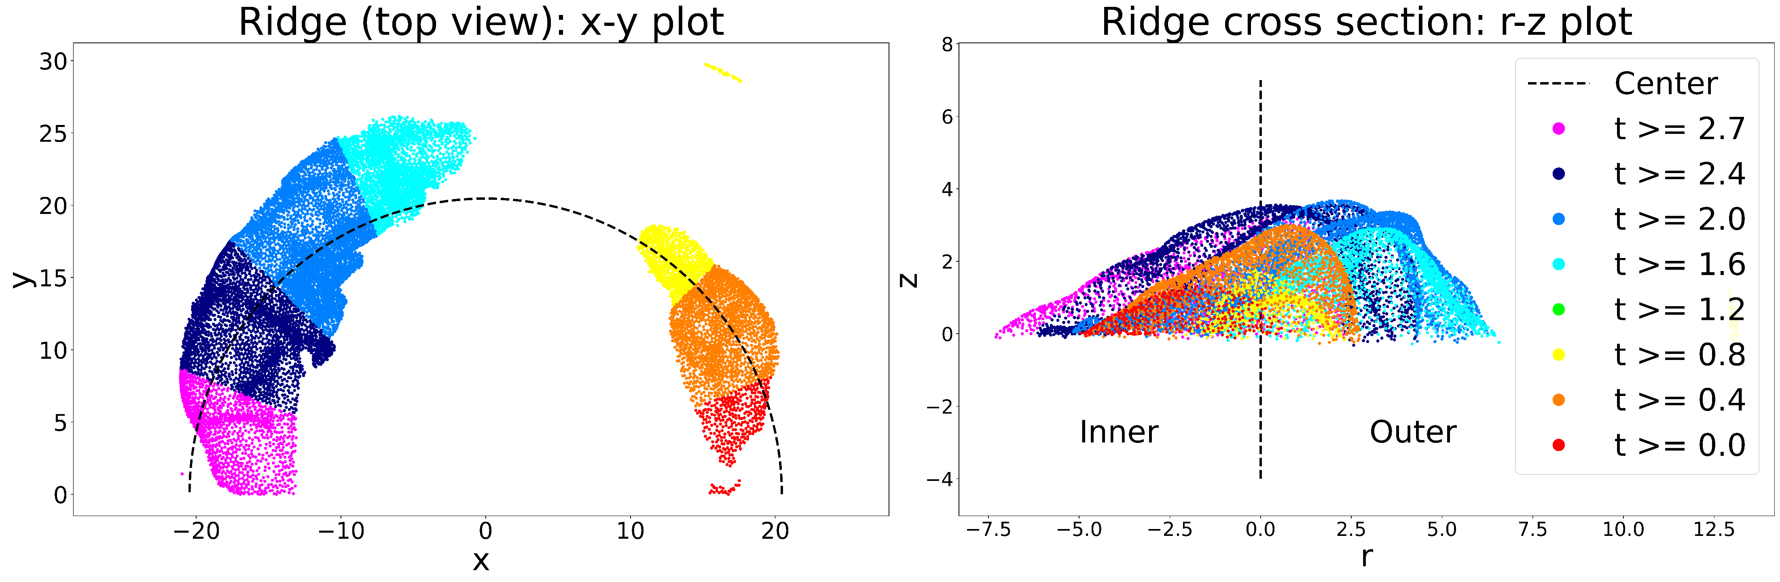
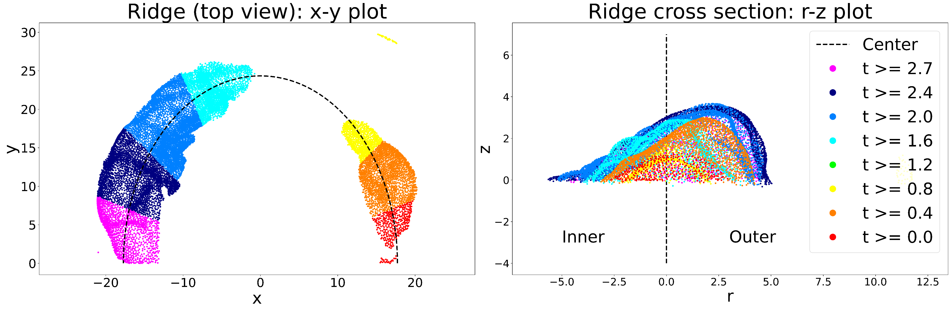


Cross Section: Learn from a Natural Ridge
How do we model the cross section?
* Learn from the natural cross section.
Circle shape
$$Δr_{n}=r_{n}−{\hat{r}}_{n}$$
Ellipse shape
$$Δr_{n}=r_{n}−{\hat{r}}_{n}$$

Slide 13
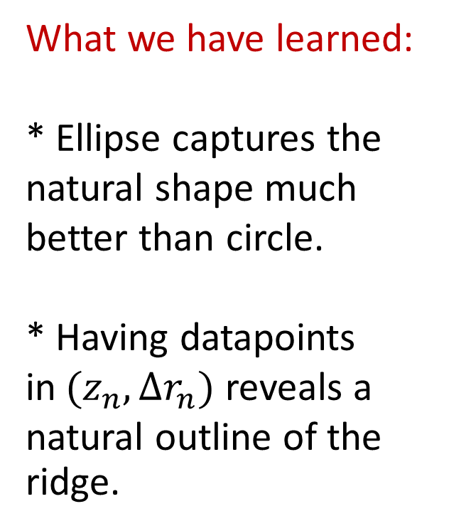


Cross Section: Natural Ridge
What we have learned:
* Ellipse captures the natural shape much better than circle.
* Having datapoints in$(z_{n},Δr_{n})$ reveals a natural outline of the ridge.
Circle
$$Δr_{n}=r_{n}−{\hat{r}}_{n}$$
Ellipse
$$Δr_{n}=r_{n}−{\hat{r}}_{n}$$

Slide 14
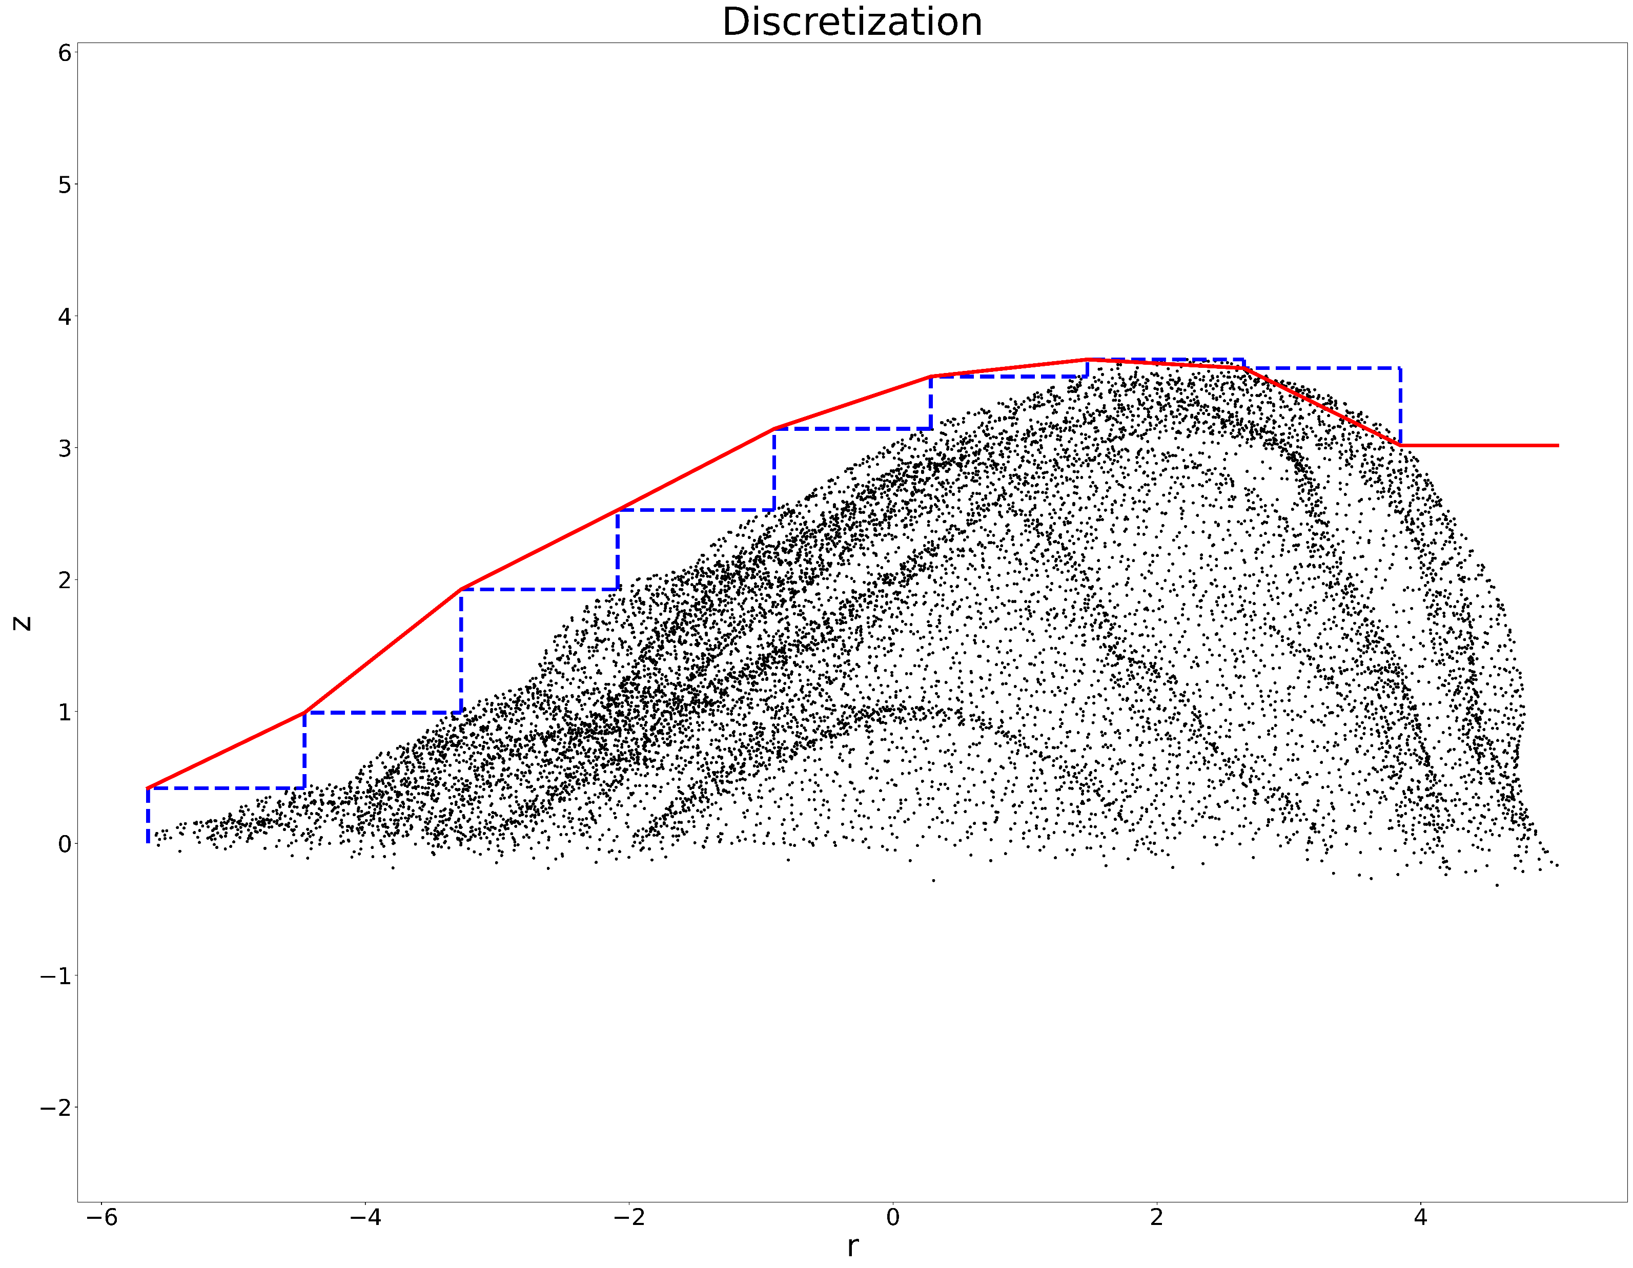
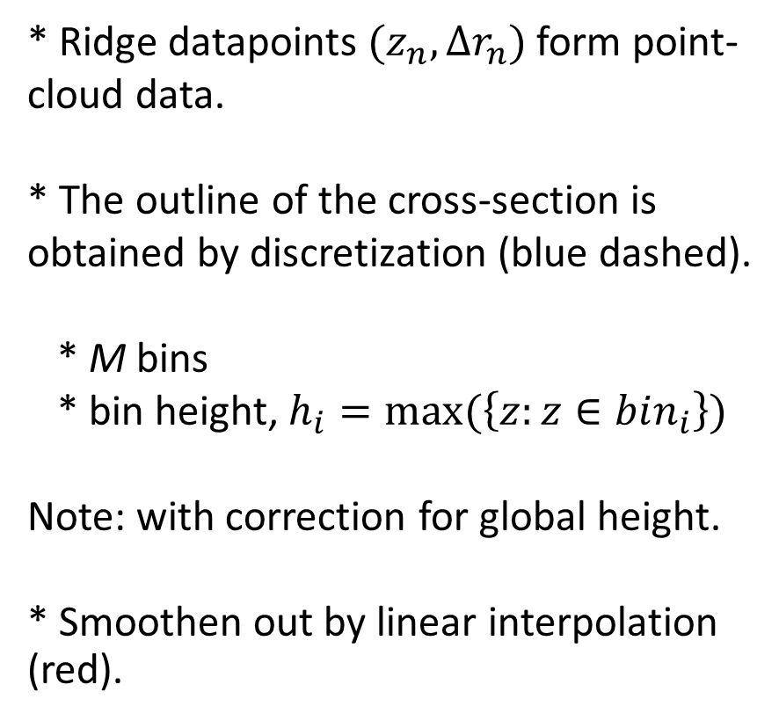
Natural Ridge to Cross-Section Outline
* Ridge datapoints$(z_{n},Δr_{n})$ form point-cloud data. * The outline of the cross-section is obtained by discretization (blue dashed).
* M bins * bin height, $h_{i}=max⁡(\left\{z:z∈bin_{i}\right\})$
Note: with correction for global height. * Smoothen out by linear interpolation (red).

Slide 15
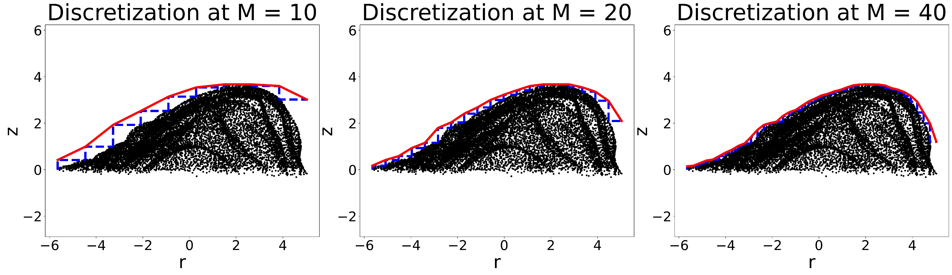
Cross-Section: Discretization
The higher resolution (more bins) we use, the closer the approximation to the natural outline.

Slide 16
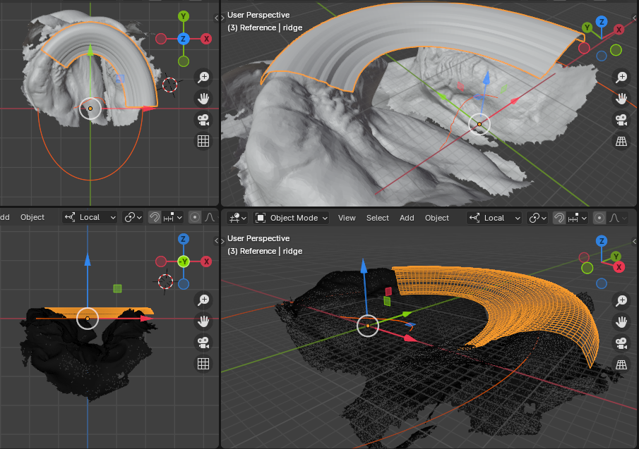
Creating The Bridge Model
A bridge with * elliptic shape * uniform cross-section
can be created using a common CAD operation, e.g., bevel in Blender.

Slide 17
Assessment
Subjective assessment by experts
* Average quantitative score: 6.75 * Major concerns: 1. The coverage of the bridge is not sufficient. 2. Adjustability of the segment.

Slide 18
Conclusion
* A pilot study on generating a 3D geometry of the bridge model---precursor to the iDNAM design.
* Achieving 3D geometry generation using low computation techniques: coordination transformation, ellipse modeling, discretization, linear interpolation, and common CAD operations.
* Assessment shows viability of the key mechanisms in the approach, yet reveals rooms for improvement.

Slide 19
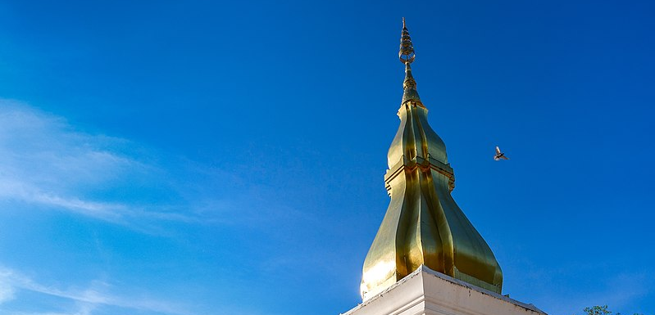
Thank you
Təşəkkür edirəm
วัดพระธาตุขามแก่น (Phrathat Kham Kaen) Khon Kaen, Thailand
image: https://commons.wikimedia.org/wiki/File:%E0%B8%A7%E0%B8%B1%E0%B8%94%E0%B8%9E%E0%B8%A3%E0%B8%B0%E0%B8%98%E0%B8%B2%E0%B8%95%E0%B8%B8%E0%B8%82%E0%B8%B2%E0%B8%A1%E0%B9%81%E0%B8%81%E0%B9%88%E0%B8%99.jpg

Slide 20
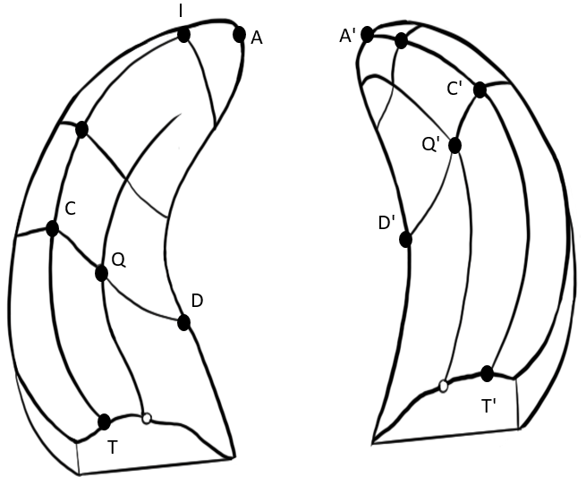
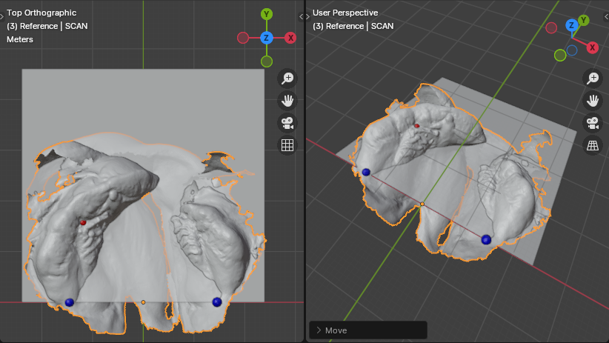
Reference points
Anthropometric landmarks

